Slide 1
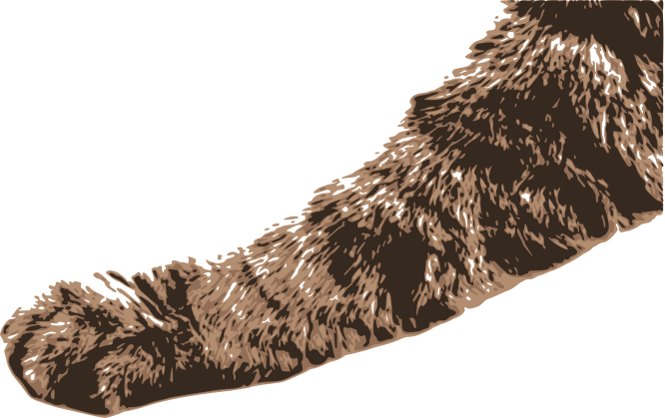
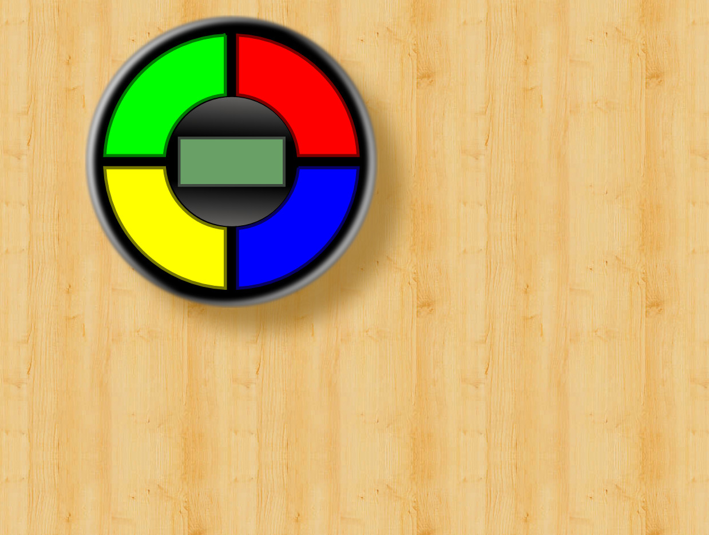
What is the capital of Spain?
Madrid
Madrad
Paris
Real Madrid

